Slide 1
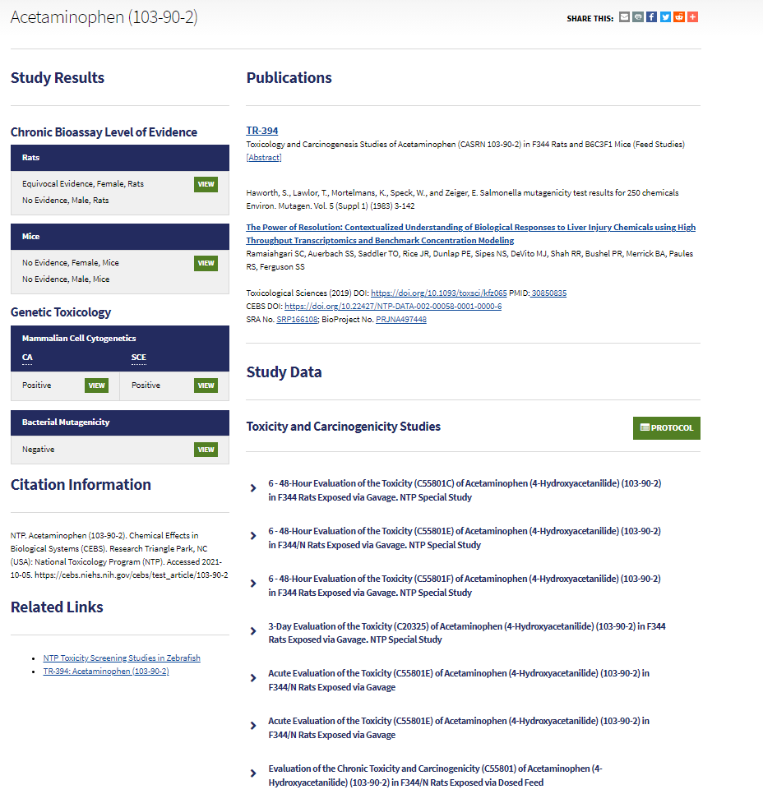
Example CEBS Test Article Page
Name and CAS no.
1
Links to reports and articles
2
3
4

Slide 2
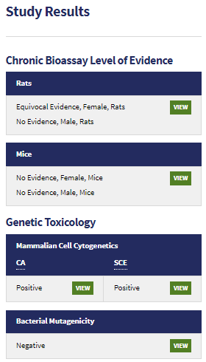
NTP reports results from multiple studies
Link to study supporting this conclusion

Slide 3
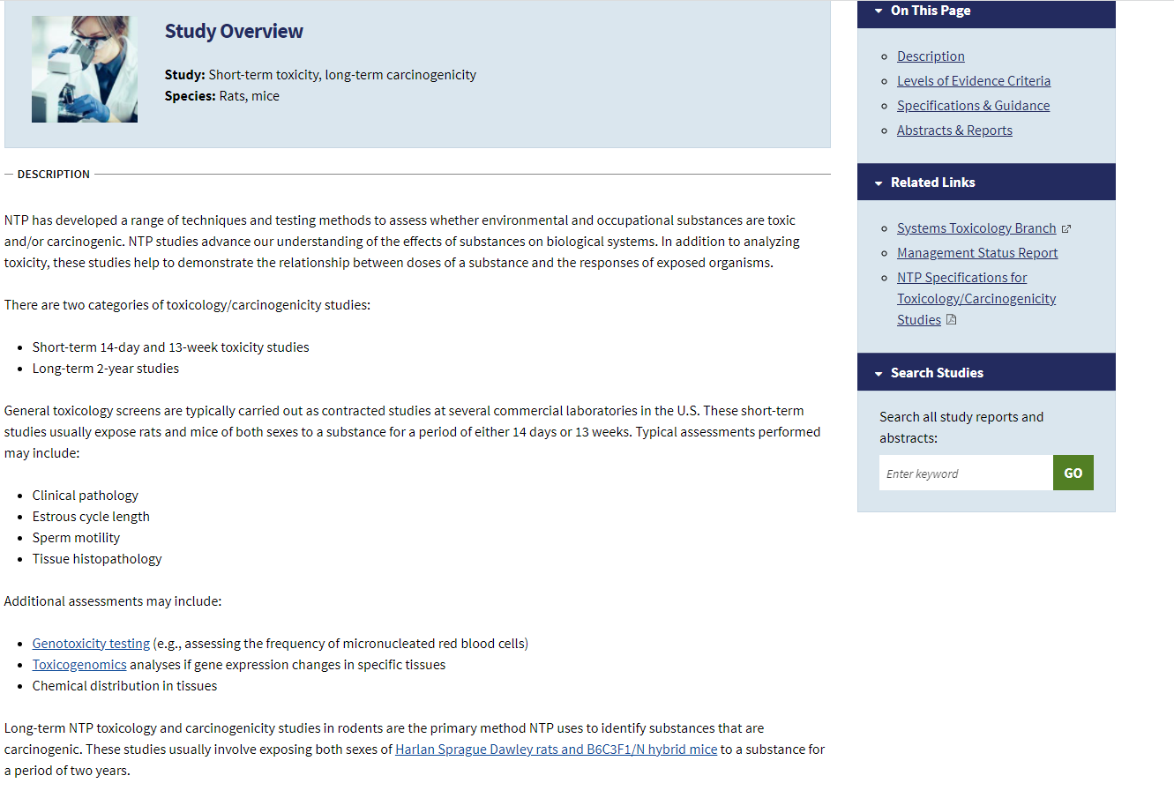
Link to NTP protocol information [12,13]

Slide 4
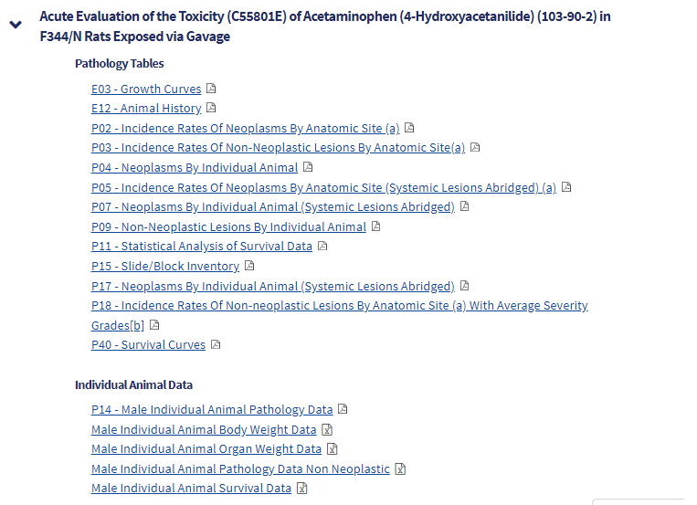
Links to the data

Slide 5
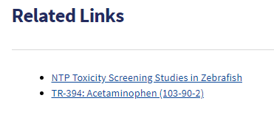
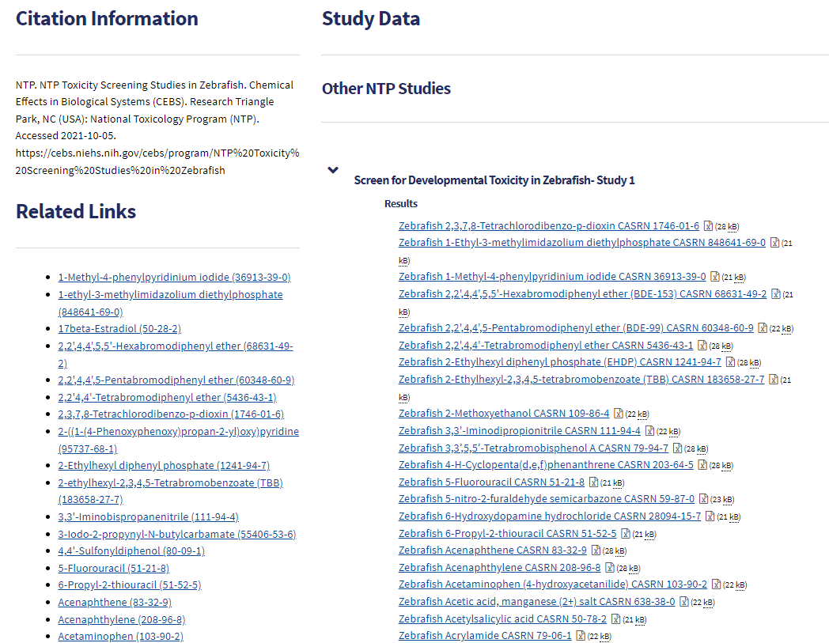
Toxicity Screening Studies in Zebrafish

