Slide 1
Supplemental Materials for CEBS Use Cases
Use case 1 – find data files for a chemical or NTP report
Enter the search term “Perfluorinated” into CEBS search
View the search results, select data page of interest
From the page navigate to the report or the data from individual studies
Retrieve data files of interest

Slide 2
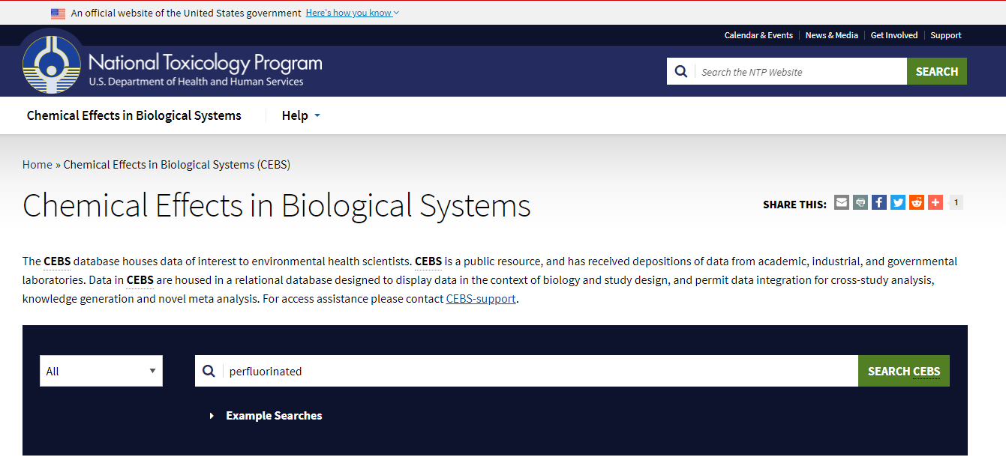
Use Case 1

Slide 3
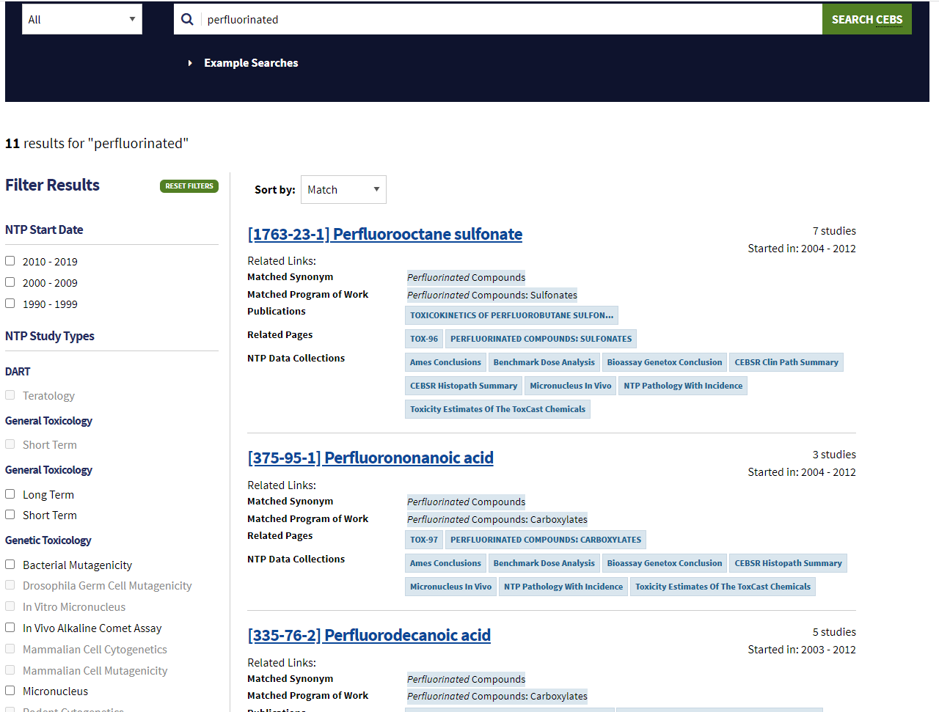

Slide 4
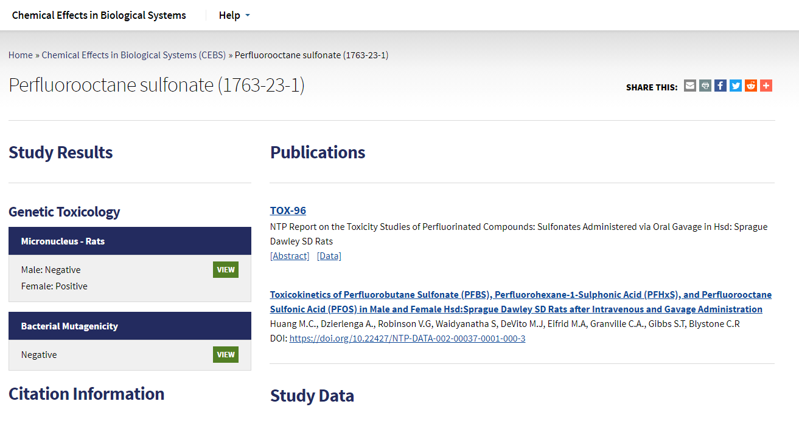
1
2

Slide 5
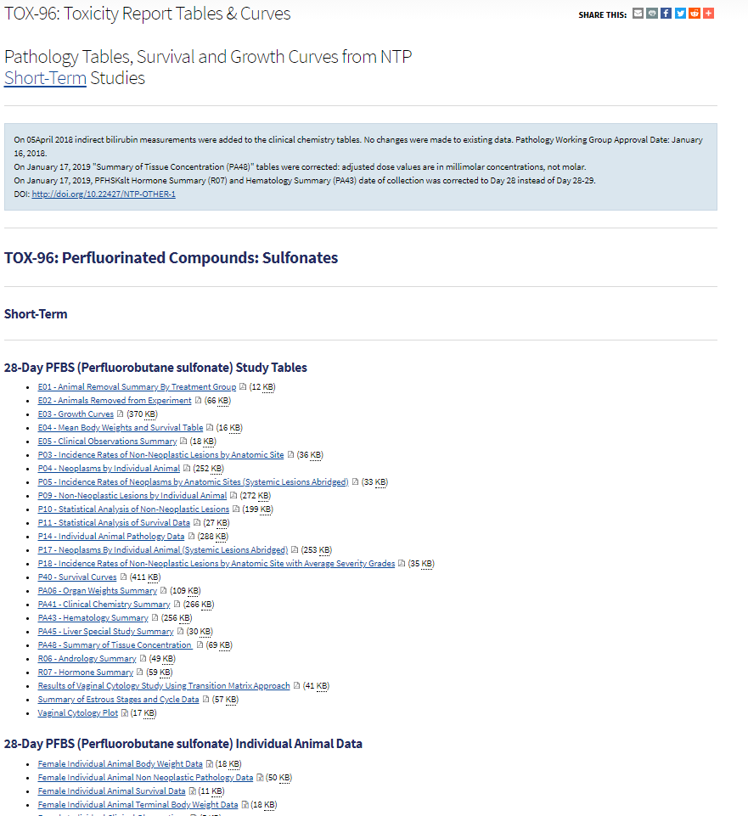
Data files for Tox-96 Report:

Slide 6
Supplemental Materials for CEBS Use Cases
Use case 2 – download file with CEBS data for a test or data type
Select “Download data” from CEBS home page
Select the link to the data type of interest
Use the FTP access to download, currently browser-based but will be updated as browsers cease to support anonymous FTP access

Slide 7
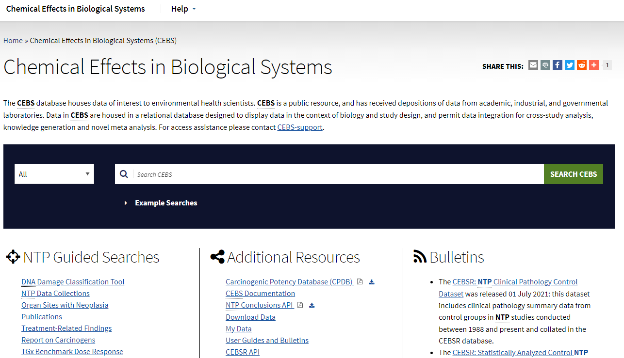
Use case 2
1

Slide 8
1

Slide 9
Firefox is recommended to access this site

Slide 10
Supplemental Materials for CEBS Use Cases
Use case 3 – interact with CEBS data to select data of interest
Use a CEBS Guided Search (arrow 1)
Use the CEBS Data Collections
Navigate to Data Collection of Interest (use the search box)
Enter Search criteria, here 7 chemicals, male rat, significant change
Retrieve the results and download or continue to filter in CEBS
Use the API to query CEBSR Data Warehouse directly

Slide 11
3A: New Guided Search: TGx Benchmark Dose Response
Select a chemical from the drop down, click “show results”
Review the accumulation plot // list of pathways (next slide)

Slide 12
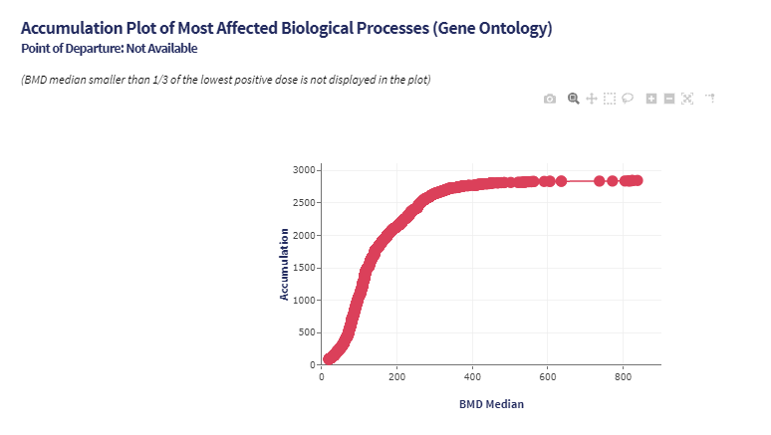
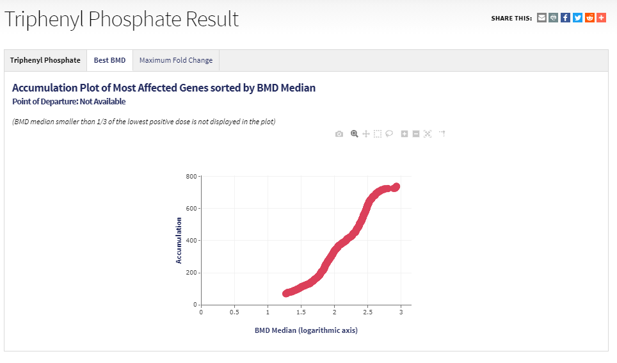
Interactive plots – hover over a point to review in CEBS
TGx Benchmark Dose Response

Slide 13
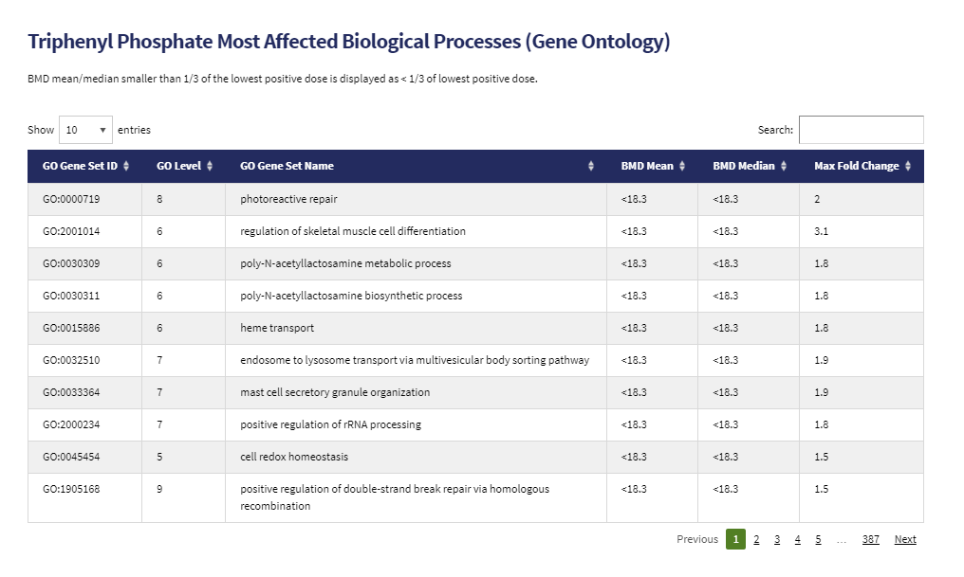
Responsive genes and pathways
TGx Benchmark Dose Response

Slide 14
New Guided Search: TGx-DDI Biomarker
Define the study design and upload your files

Slide 15
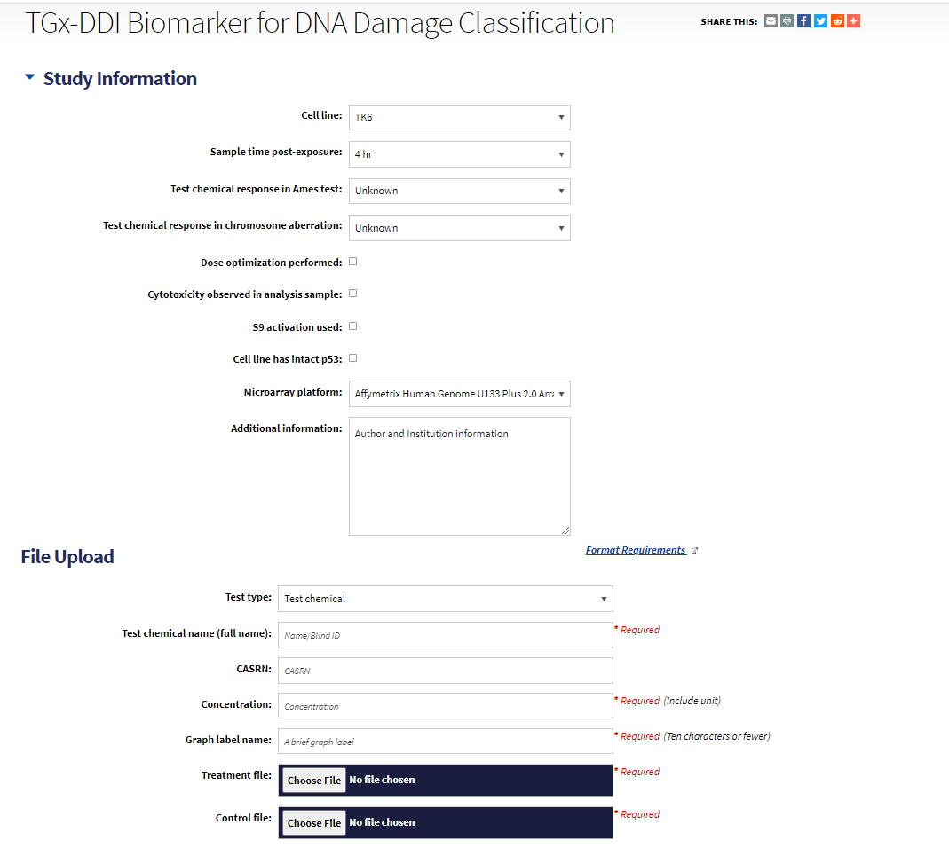
TGx-DDI Biomarker for DNA Damage Classifier

Slide 16
Results of classification analysis
Download data files and results or view on screen
TGx-DDI Biomarker for DNA Damage Classifier

Slide 17
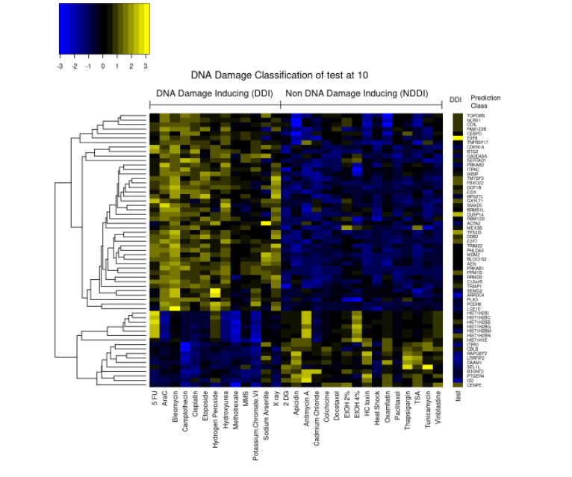
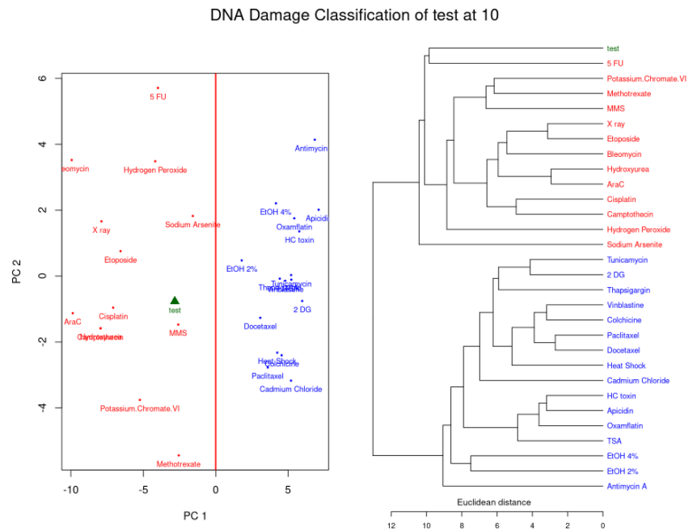
Results: Chemical “Test” at concentration = 10
TGx-DDI Biomarker for DNA Damage Classifier

Slide 18
3B: CEBS Data Collections
Enter the Guided Search and find the Data Collection of interest
Supplemental Materials contains a list of current Data Collections
Use the filter boxes at the top of the page to filter for data of interest
Male, rat
List of seven chemicals
Select findings that are significant at p < 0.05 or p<0.01
Data matching your search are at the bottom of the page

Slide 19
1
2

Slide 20
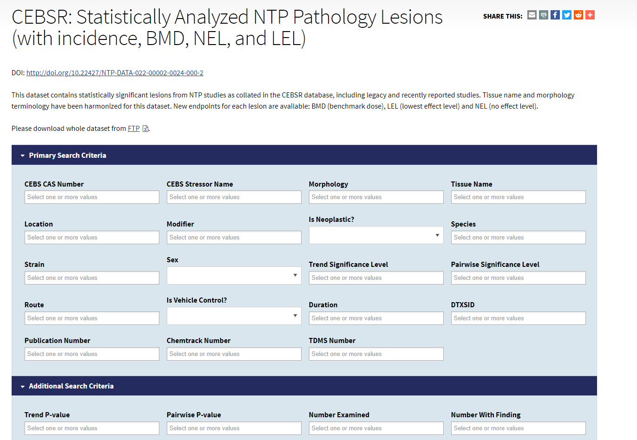
Use CEBS Data Collections:

Slide 21
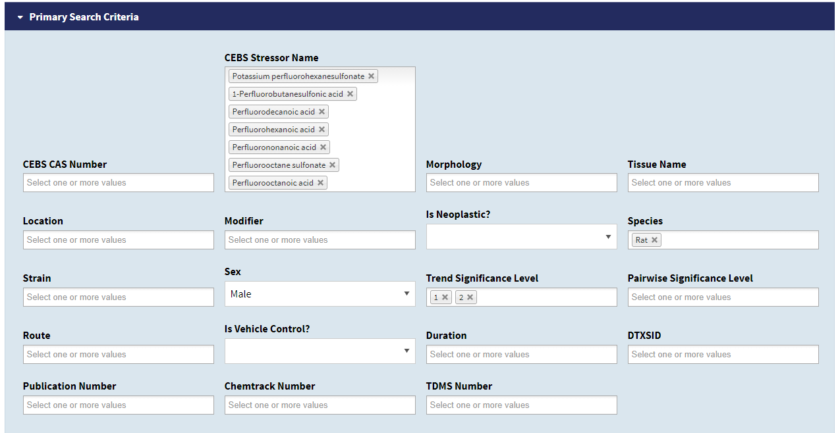

Slide 22
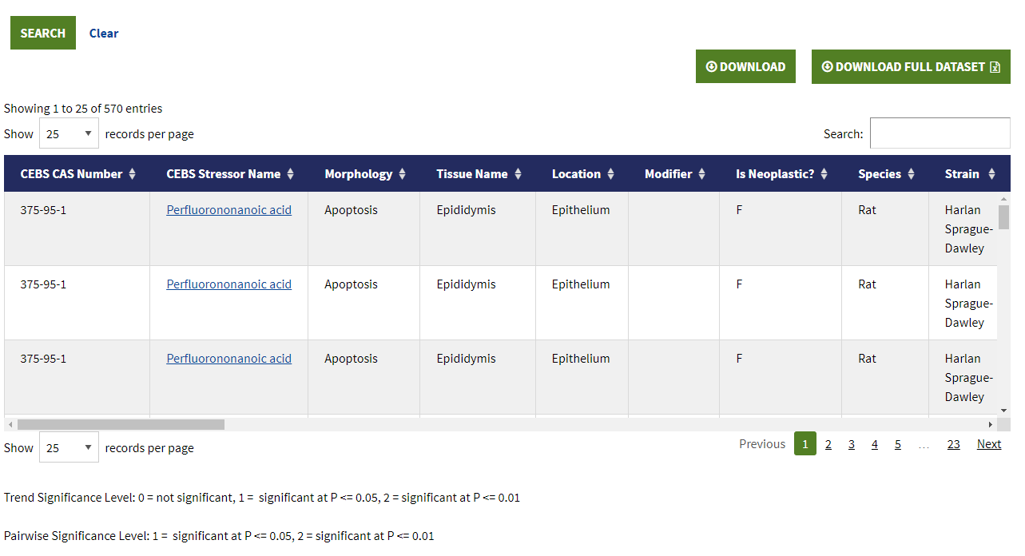

Slide 23
3C: Review data in CEBSR
Access is via GraphQL API
Approach – open a template query (https://cebs.niehs.nih.gov/cebs/paper/14893)
Paste into GraphQL API
(https://manticore.niehs.nih.gov/cebsr-api)
Modify the query to obtain result of interest

Slide 25
Requires a few clicks

Slide 26
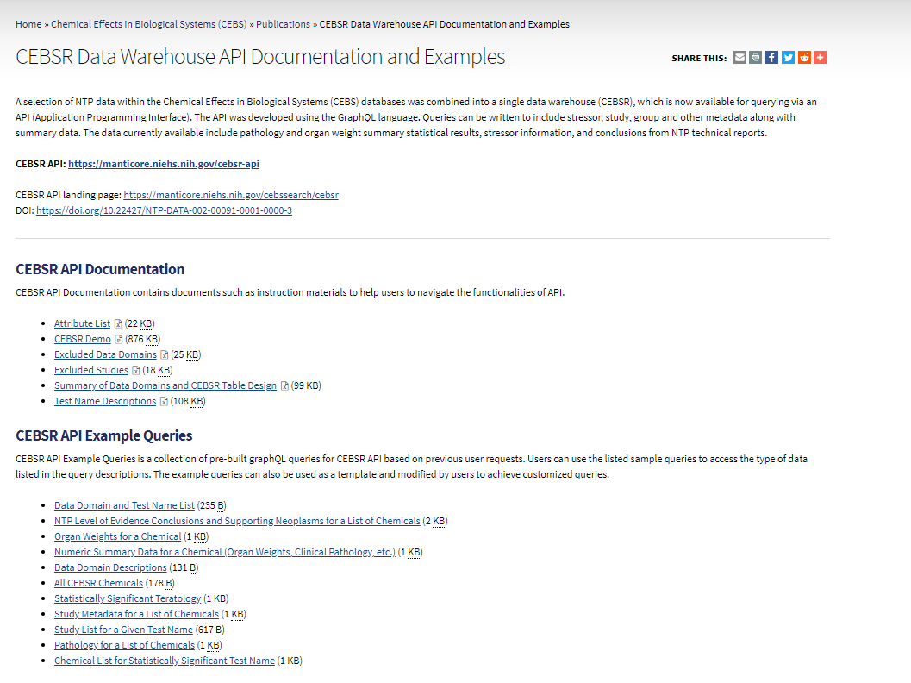
https://cebs.niehs.nih.gov/cebs/paper/14893:

Slide 27
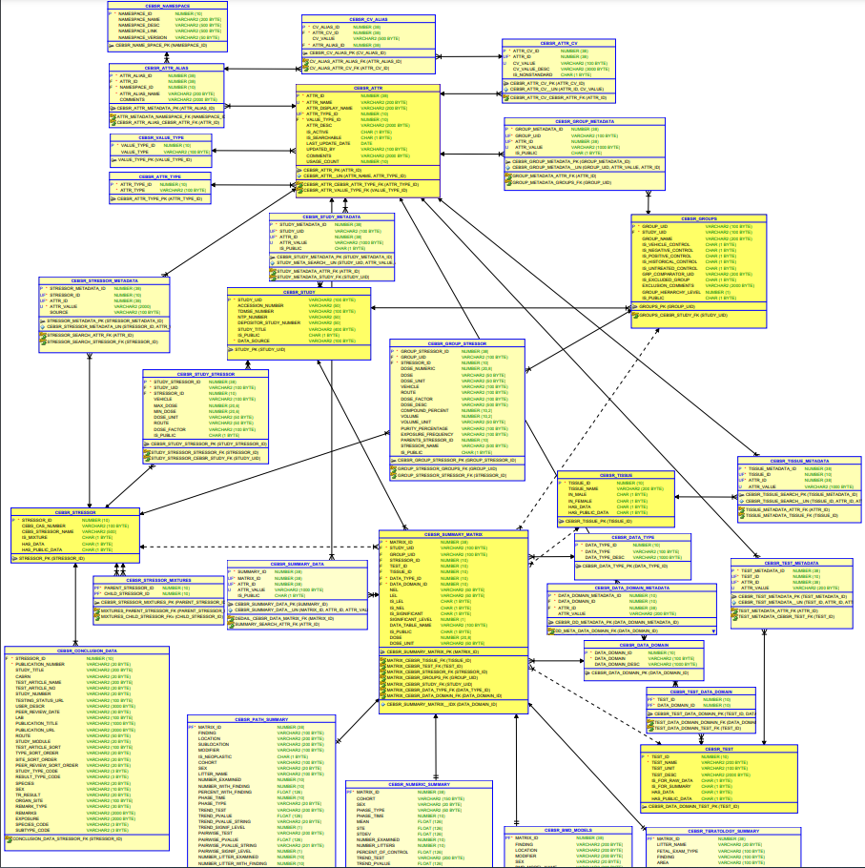
CEBSR schema From ref [22]

