Slide 1
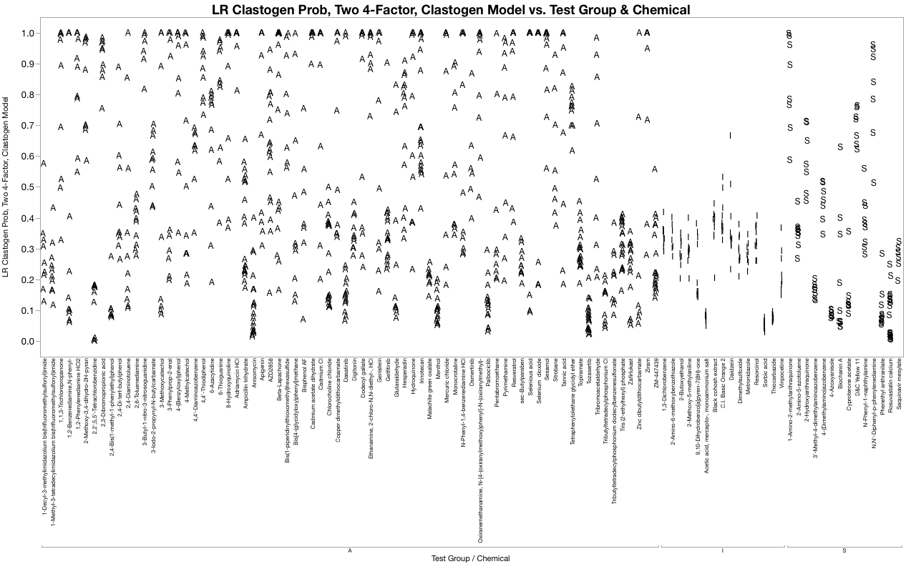
Figure S2a. Logistic Regression, Clastogen Probabilities
LR Clastogen Probabilities vs. Test Group & Chemical

Slide 2
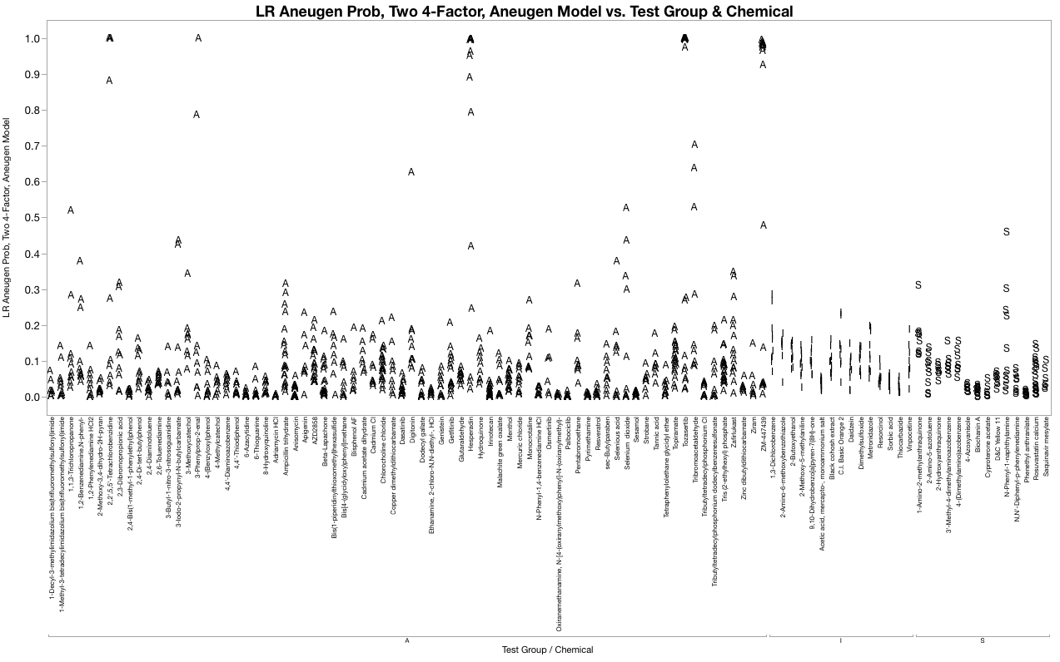
Figure S2b. Logistic Regression, Aneugen Probabilities
LR Aneugen Probabilities vs. Test Group & Chemical

