Slide 1
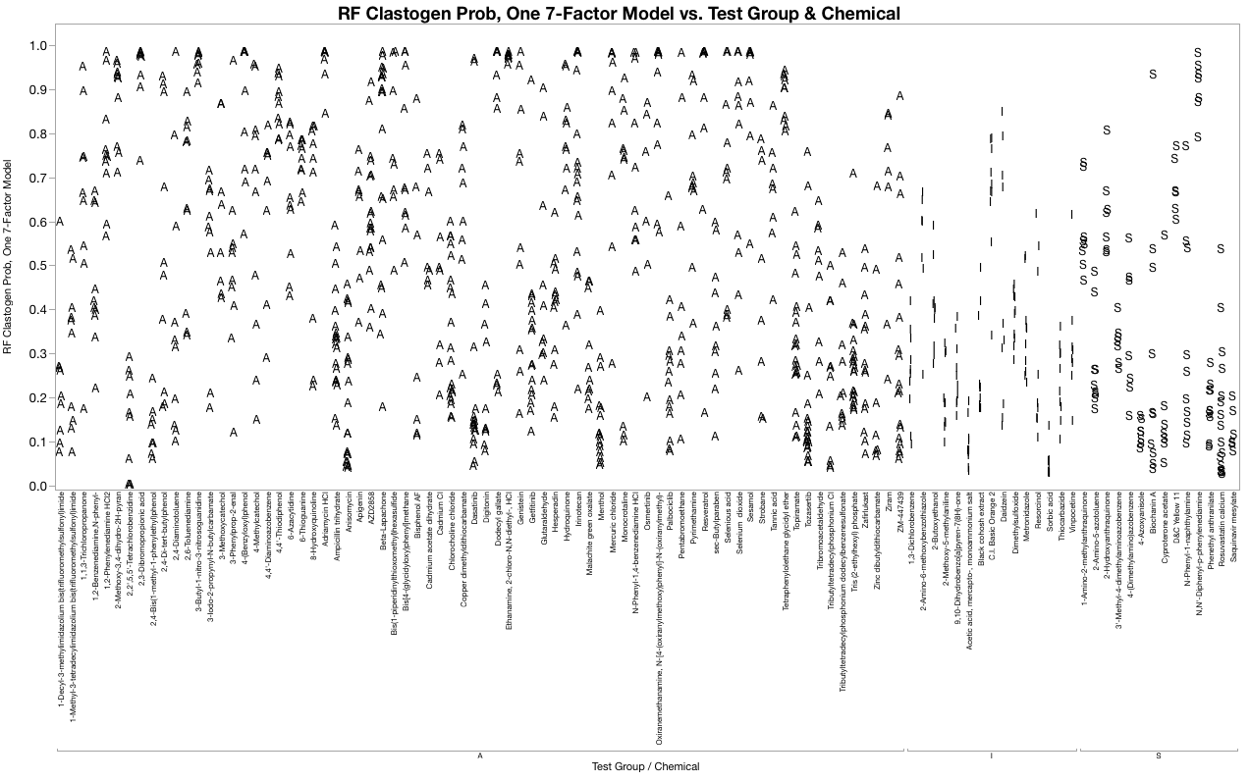
Figure S3a. Random Forest, Clastogen Probabilities
RF Clastogen Probabilities vs. Test Group & Chemical

Slide 2
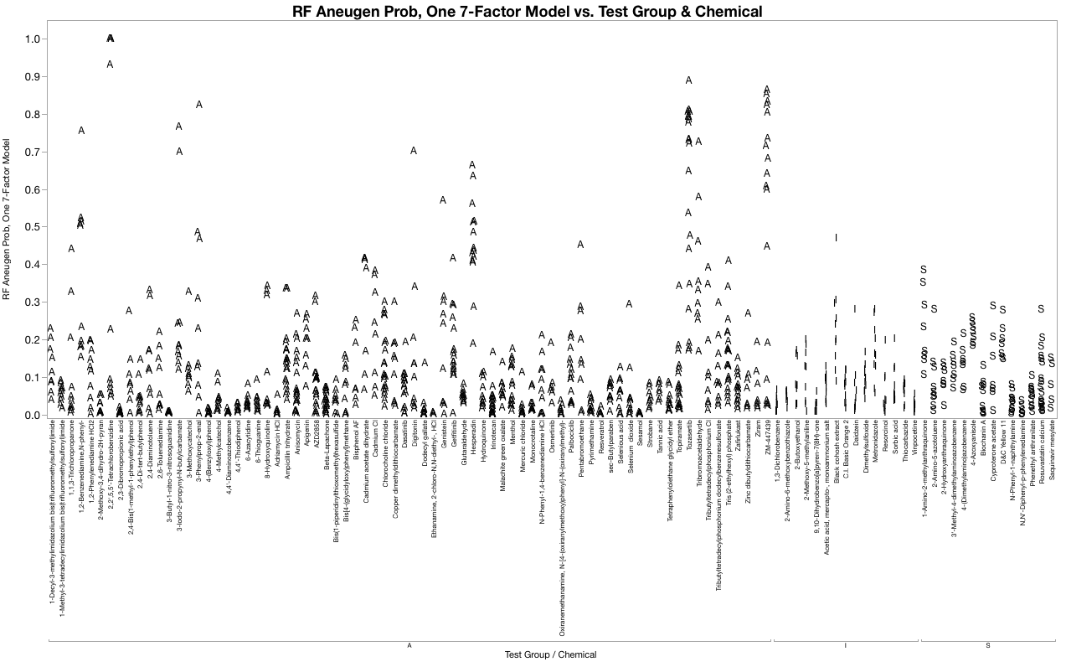
Figure S3b. Random Forest, Aneugen Probabilities
RF Aneugen Probabilities vs. Test Group & Chemical

